Slide 1
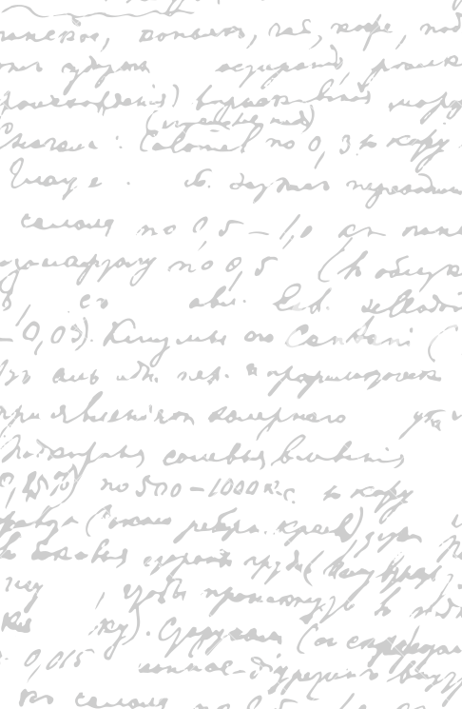

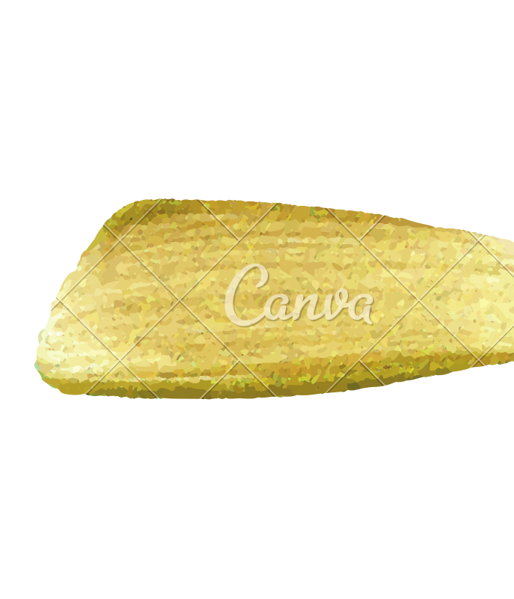

Ming Wu (Andrew) 2133861w
Laser Mate!
Project Supervisor Meeting 14
25 February 2021

Slide 2
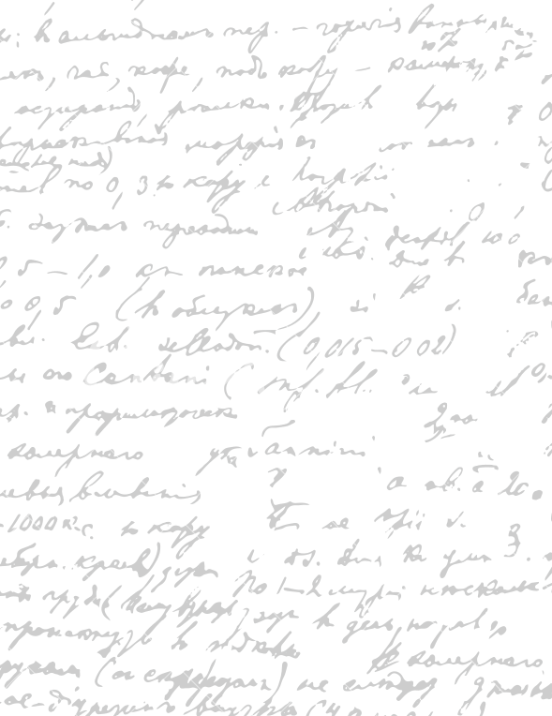



Start Recording

Slide 3
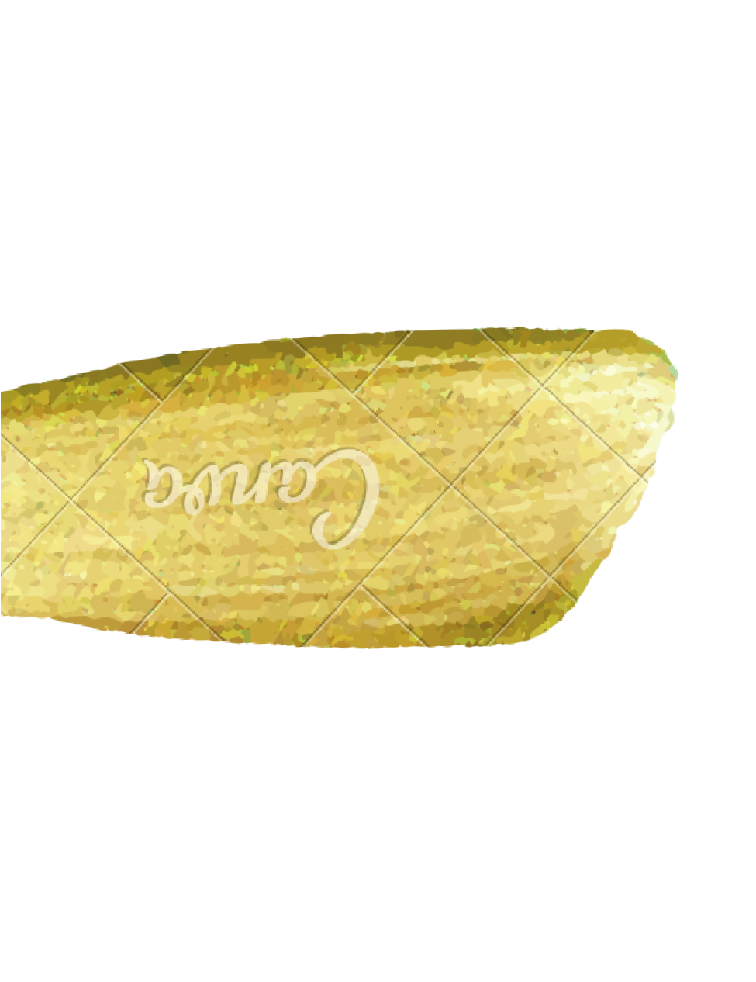
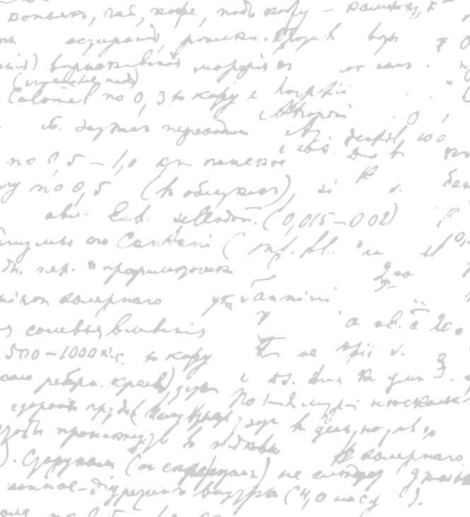

Evaluation – Google form for 1) native-speaker, 2) non-native speaker (Done)
Final Software Product
Database organization
Paper prototype
Design principles
Proofreading dissertation
Remove and add multiple orders
Complicated things that they will fail at too many dishes
- non-speaker – less precious – order 3 meals, remove 1 meals

Slide 4
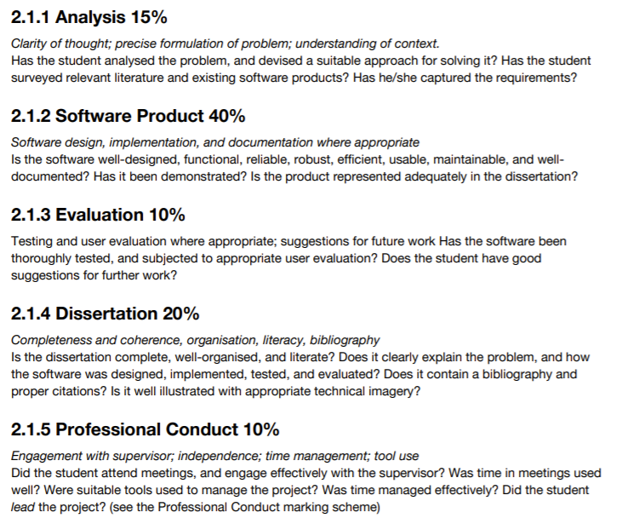
If finish proofreading dissertation, evaluating Current Progress
What is the score and strength and weaknesses
Analysis –
Software Product –
Evaluation –
Dissertation –
Professional Conduct -

Slide 5
End

